Slide 1


Drug used in Renal failure, anticoagulant and fibrinolytic agents PHA 317 (Basic Pharmacology and Therapeutics)
Dr. A.A BUSARI
Consultant Physician & Clinical Pharmacologist. Department of Pharmacology Therapeutics &Toxicology. College of Medicine,
University of Lagos.

Slide 2
Objectives
Describe the basic anatomy, physiology and functions of the kidney
Explain the key elements of clotting mechanism
Discuss the salient pharmacology of drug therapy in renal failure
Learn the rational use of diuretics
Describe how heparin and oral anticoagulants produce their effect.
Enumerate the indication of heparin and oral anticoagulants
Identify major adverse reactions associated with heparin and oral anticoagulants

Slide 3
outline
Anatomy and functions of the kidney
Renal failure
Pharmacology of diuretics
Mechanism and site of action of diuretic
Adverse effect of Diuretics
Anticoagulant
Fibrinolytics
Conclusion

Slide 4
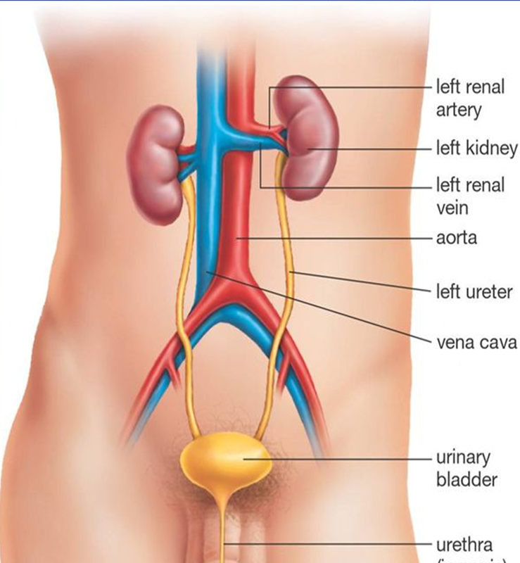
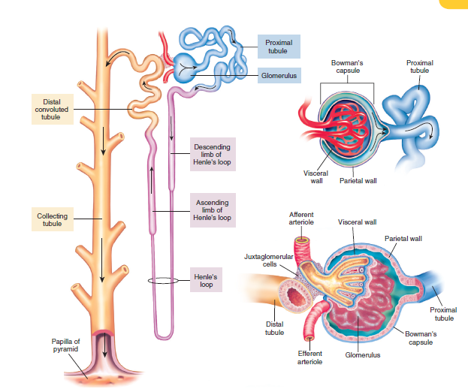
Anatomy and functions of the kidney

Slide 5
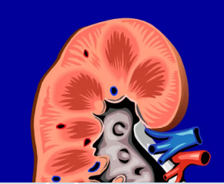
Anatomy and functions of the kidney
The kidneys are composed of about 1 million functional units called nephrons.
Each nephron glomerulus and a capsule surrounding the glomerulus (Bowman’s capsule), leading to the proximal tubule, loop of Henle, distal tubule, and, finally, collecting tubule.

Slide 6
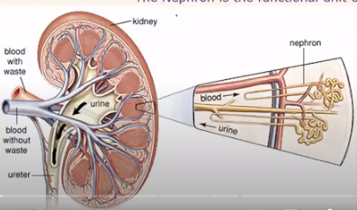
Anatomy and functions of the kidney
Regulate
Fluid volume
Electrolytes
Acid-base balance
Secrete
Renin
Erythropoietin
Calcitriol

Slide 7
Renal failure
Deterioration in renal function
Major public health burden with increase prevalence, morbidity, mortality
Acute (5%) or Chronic (17%)
Acute – Hypovolemia, Sepsis, Toxins
Chronic – HTN, DM, CGN, Obstructive, Toxin, Autoimmune, genetic
Symptoms – Body swelling, vomiting, nausea, hiccups, body weakness, seizure, coma, death
Treatment – underlying cause, diuretics for body swelling

Slide 8
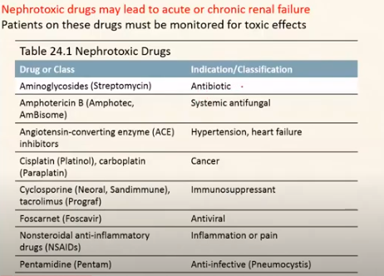

Slide 9
Drugs used in renal failure

Slide 10
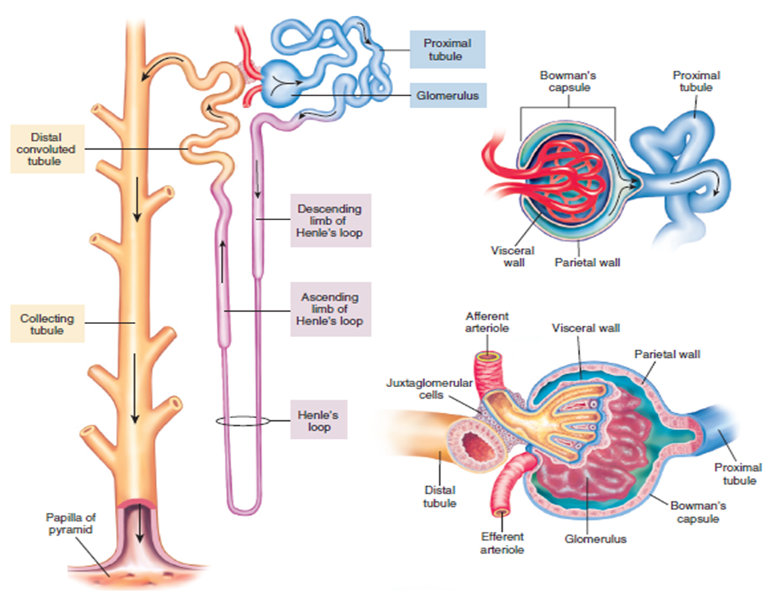
Diuretics
Drugs that increased urine flow
Increase renal excretion of salt and water
Removes excessive extracellular fluid from the body.
Inhibitors of renal ion transporters that decrease the reabsorption of Na+ at different sites in the nephron.
Water simply follows Na+ passively

Slide 11
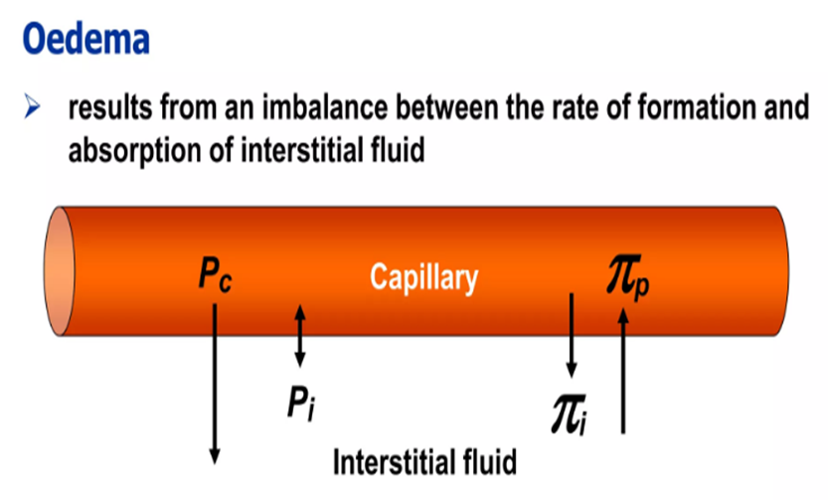
Diuretics
Diuretics are used in various conditions of causing edematous or non-edematous state.
Non-edematous use – HTN, Hypercalcemia, Diabetes insipidus:
Several commonly encountered causes of edema include the following.
Heart failure:
Hepatic ascites:
Nephrotic syndrome
Renal failure

Slide 12
Diuretics
Approximately 180 liters of fluid is filtered from the glomerulus per day.
Normal urine out put is 1-5 liters per day.
Remaining is reabsorbed in different areas of nephron.
There are three mechanisms involved in urine formation
(a) glomerular filtration
(b) tubular reabsorption
(c) Tubular secretion.

Slide 13
Classification of diuretics
Thiazides and related diuretics: e.g. Hydrochlorothiazide chlorthalidone, bendrofluazide etc.
Loop diuretics: e.g. furosemide, ethacrynic acid, etc.
Potassium sparing diuretics e.g. triamterene, amiloride, spironolactone, etc.
Carbonic anhydrase inhibitors e.g. acetazolamide
Osmotic diuretics e.g. mannitol, glycerol

Slide 14
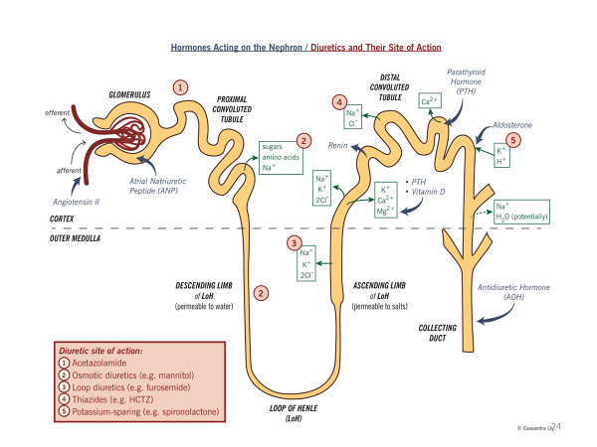
Mechanism and site of action of diuretic

Slide 15
Mechanism and site of action of diuretic
DIURETICS | EXAMPLES | MECHANISM | LOCATION
Thiazides | bendroflumethiazide, hydrochlorothiazide | Inhibits reabsorption by Na⁺/Cl⁻ symporter | Distal convoluted tubules (DCT)
Loop diuretics | bumetanide ethacrynic acid furosemide torsemide | Inhibits the Na-K-Cl symporter | Medullary thick ascending limb
Potassium-sparing diuretics | amiloride spironolactone, eplerenone, triamterene potassium canrenoate. | Inhibition of Na+/K+ exchanger: Spironolactone inhibits aldosterone action, Amiloride inhibits epithelial sodium channels | Cortical collecting ducts

Slide 16
Pharmacology of diuretics
1. Thiazide diuretics
Act by inhibiting NaCl symport at the distal convoluted tubule.
They are used in hypertension, edema of hepatic, renal and cardiac origin.
Adverse effects: epigastric distress, nausea, vomiting, weakness, fatigue, dizziness, impotence, jaundice, skin rash, hypokalemia, hyperuricemia, hyperglycaemia and visual disturbance.

Slide 17
Pharmacology of diuretics
2. Loop diuretics:
Inhibit Na+- K – 2Cl symporter in the ascending limb.
Adverse effects: Hypokalemia, nausea, anorexia, vomiting epigastric distress, fatigue weakness muscle cramps, drowsiness. Dizziness, hearing impairment and deafness are usually reversible.
Therapeutic uses: acute pulmonary edema, edema of cardiac, hepatic and renal disease. Hypertension, cerebral edema, forced diuresis in drug over dose

Slide 18
Pharmacology of diuretics
3. Potassium sparing diuretics
Mechanism of action: spironolactone, triamterene, amiloride are mild diuretics causing diuresis by increasing the excretion of sodium, calcium and bicarbonate but decrease the excretion of potassium.
Adverse effects: G.I. disturbances, dry mouth, rashes confusion, orthostatic hypotension, hyperkalaemia. Hyponatraemia
Therapeutic uses: used with conjunction with thiazides or loop diuretics in edema due to, cardiac failure nephrotic syndrome and hepatic disease.

Slide 19
Pharmacology of diuretics
4. Carbonic anhydrase inhibitors:
These drugs like acetazolamide inhibit the enzyme carbonic anhydrase in renal tubular cells and lead to increased excretion of bicarbonate, sodium and potassium ions in urine.
In eye it results in decrease information of aqueous humor.
Therefore these are used in treatment of acute angle glaucoma.
Main adverse effects of these agents are drowsiness, hypokalemia, metabolic acidosis and epigastric distress.

Slide 20
Pharmacology of diuretics
5. Osmotic diuretics:
These drugs like mannitol and glycerine (glycerol) are freely filtered at the glomerulus and are relatively inert pharmacologically and undergo limited reabsorption by renal tubule.
These are administered to increase significantly the osmolality of plasma and tubular fluid.
Some times they produce nausea, vomiting, electrolyte imbalances.
They are used in cerebral edema and management of poisoning.

Slide 21
Adverse effect of Diuretics
Hyponatraemia – sometimes severe in elderly.
Hypokalaemia – due to Na – K ions exchange,
Hypomagnesaemia;
Hyperuricaemia/Gout – most diuretics reduce urate clearance,
Hyperglycemia – thiazides reduce glucose tolerance:
Hypercalcaemia – thiazides reduce urinary calcium ion clearance
Hypercholesterolaemia – high-dose - small increase in plasma LDL cholesterol
Erectile dysfunction.
Increased plasma renin,
Idiosyncratic reactions, including rashes

Slide 22
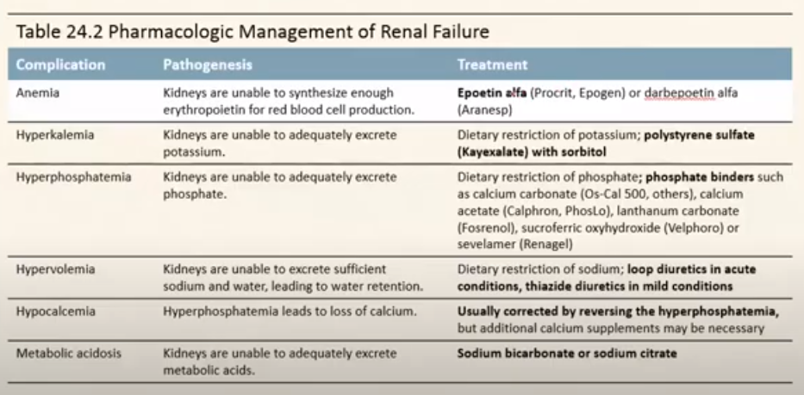
Other drugs used in renal failure

Slide 23
Thank you!

Slide 24
Anticoagulant and Fibrinolytic agents

Slide 25
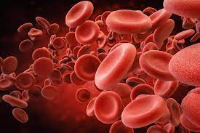
Introduction
Terms
Hematopoiesis : the production of circulating erythrocytes, platelets and leukocytes from undifferentiated stem cells.
Over 200 billion new cells per day
Haemostasis : spontaneous arrest of bleeding from a damaged blood vessel = formation Blood clot
Ancient Greek roots
"heme" meaning blood,
"stasis" meaning halting.

Slide 26

Haemostasis
Involves 3 steps occur in a rapid sequence.
1. Vascular spasm,
2. Platelet plug formation.
3. Blood coagulation
Steps:
Vascular Injury vasospasm platelets adhesion platelets aggregation coagulation cascade fibrin formation

Slide 27
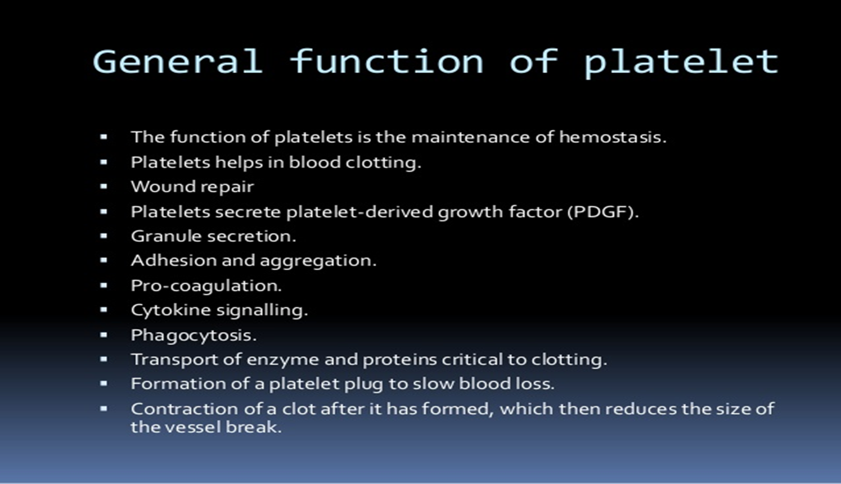
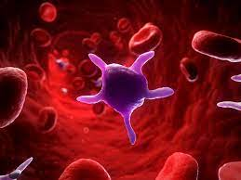
Functions of platelets

Slide 28
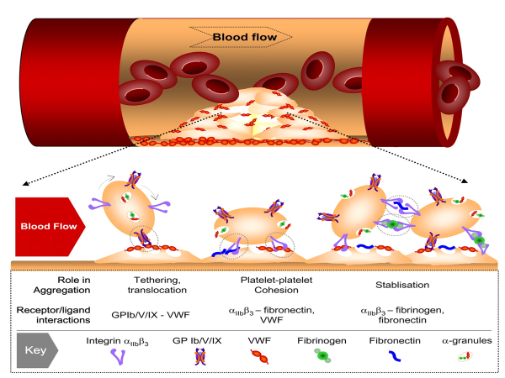
Platelet activation

Slide 29
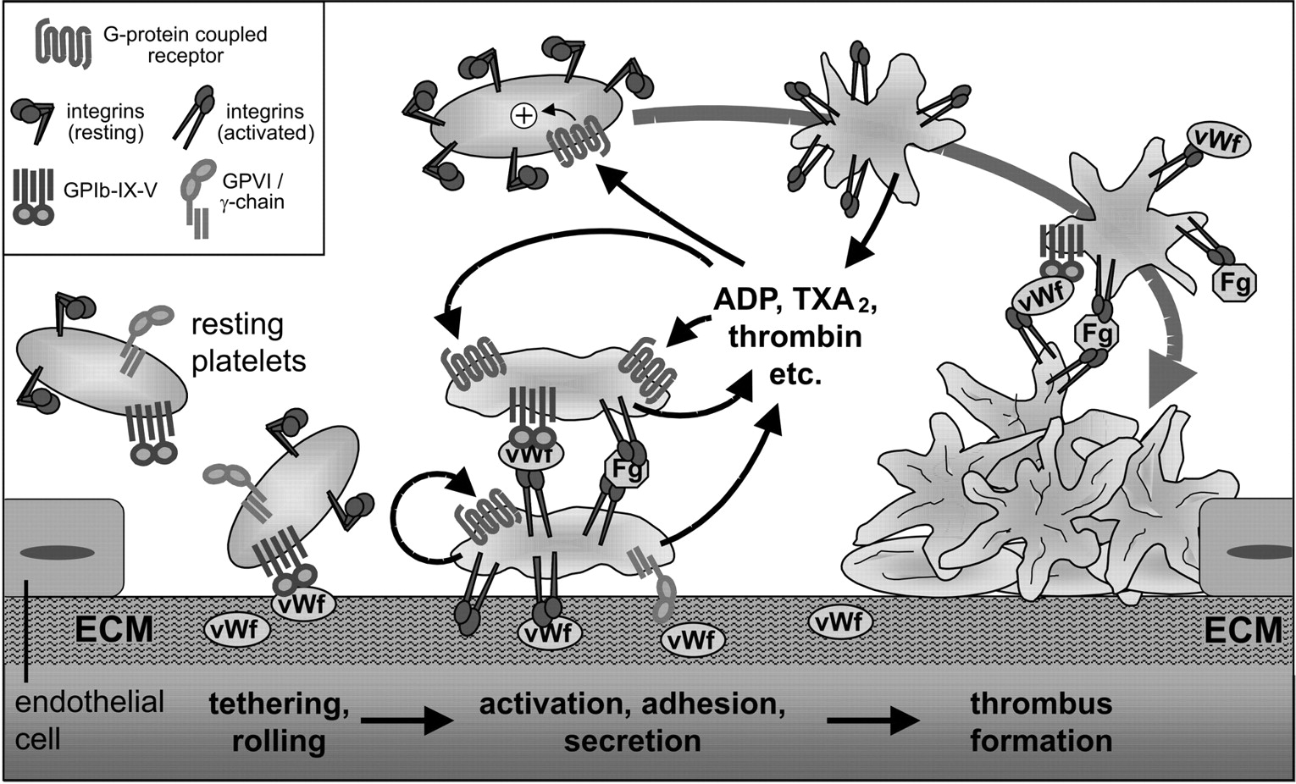
Platelet plug formation

Slide 30
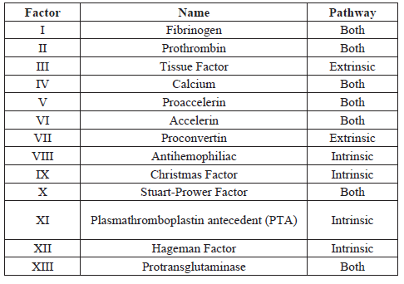
Clotting factors

Slide 31
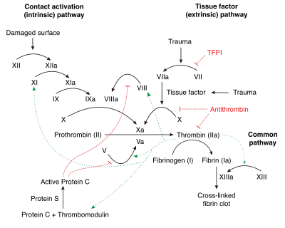
Clotting cascade

Slide 32
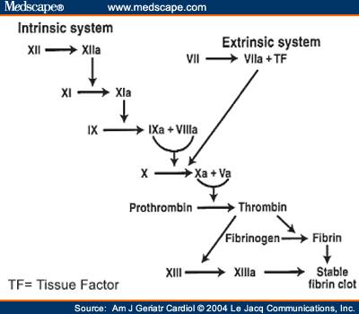
Clotting cascade

Slide 33
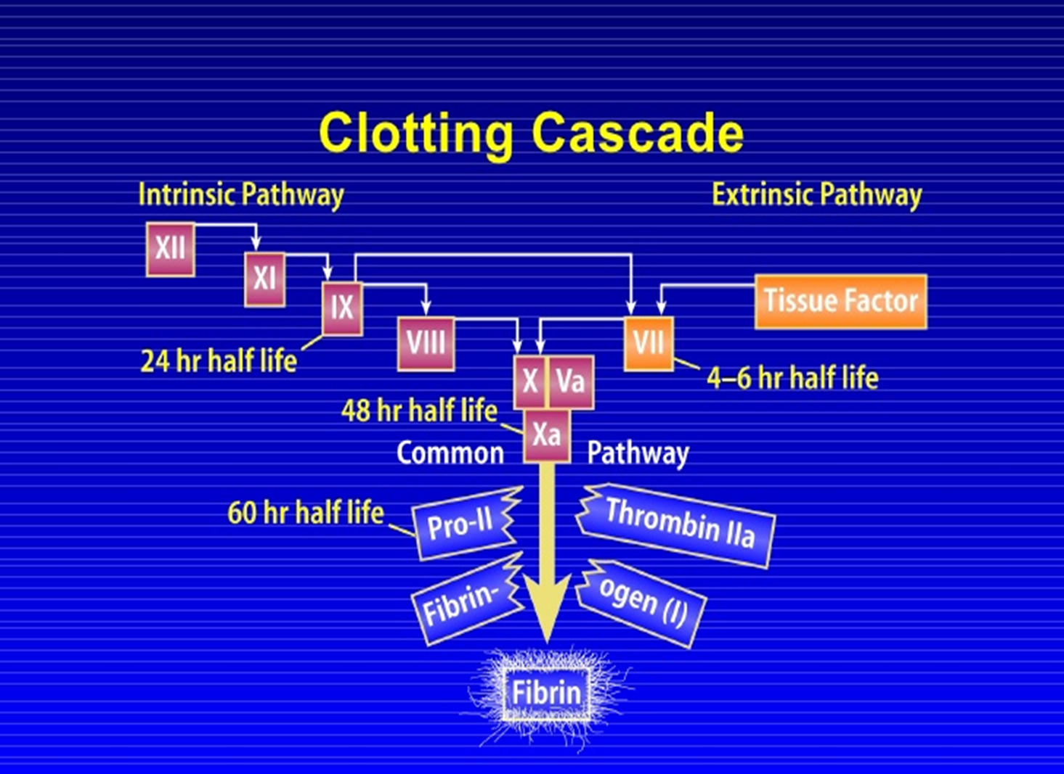
Clotting cascade

Slide 34
Cofactors
Calcium and phospholipid (a platelet membrane constituent): are required for the tenase and prothrombinase complexes to function.
Calcium mediates the binding of the complexes via the terminal gamma-carboxy residues on Xa and IXa to the phospholipid surfaces expressed by platelets, as well as procoagulant microparticles or microvesicles shed from them.
Calcium is also required at other points in the coagulation cascade.

Slide 35
Cofactors
Vitamin K is an essential factor to a hepatic gamma-glutamyl carboxylase that adds a carboxyl group to glutamic acid residues on factors II, VII, IX and X, as well as Protein S, Protein C and Protein Z.
In adding the gamma-carboxyl group to glutamate residues on the immature clotting factors Vitamin K is itself oxidized.

Slide 36
Fibrinolysis/
thrombolysis

Slide 37
Fibrinolysis/thrombolysis
Eventually, blood clots are reorganised and resorbed by a process termed fibrinolysis.
The main enzyme responsible for this process (plasmin) is regulated by various activators and inhibitors.
Fibrinolysis is a process of dissolving intravascular clot.
It can be primary (by plasmin) or secondary (by drugs)

Slide 38
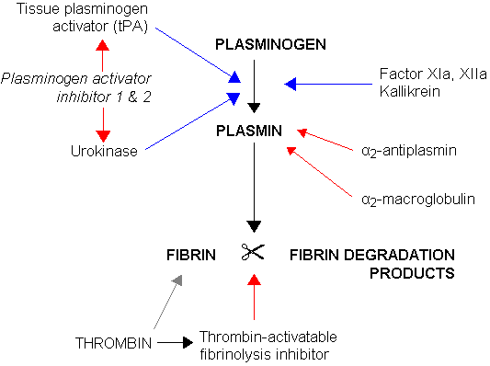
Fibrinolysis

Slide 39
Anti-thrombotic
The treatment and prevention of thrombosis involves three classes of drugs, namely
Anticoagulants,
Antiplatelet drugs and
Fibrinolytics.

Slide 40
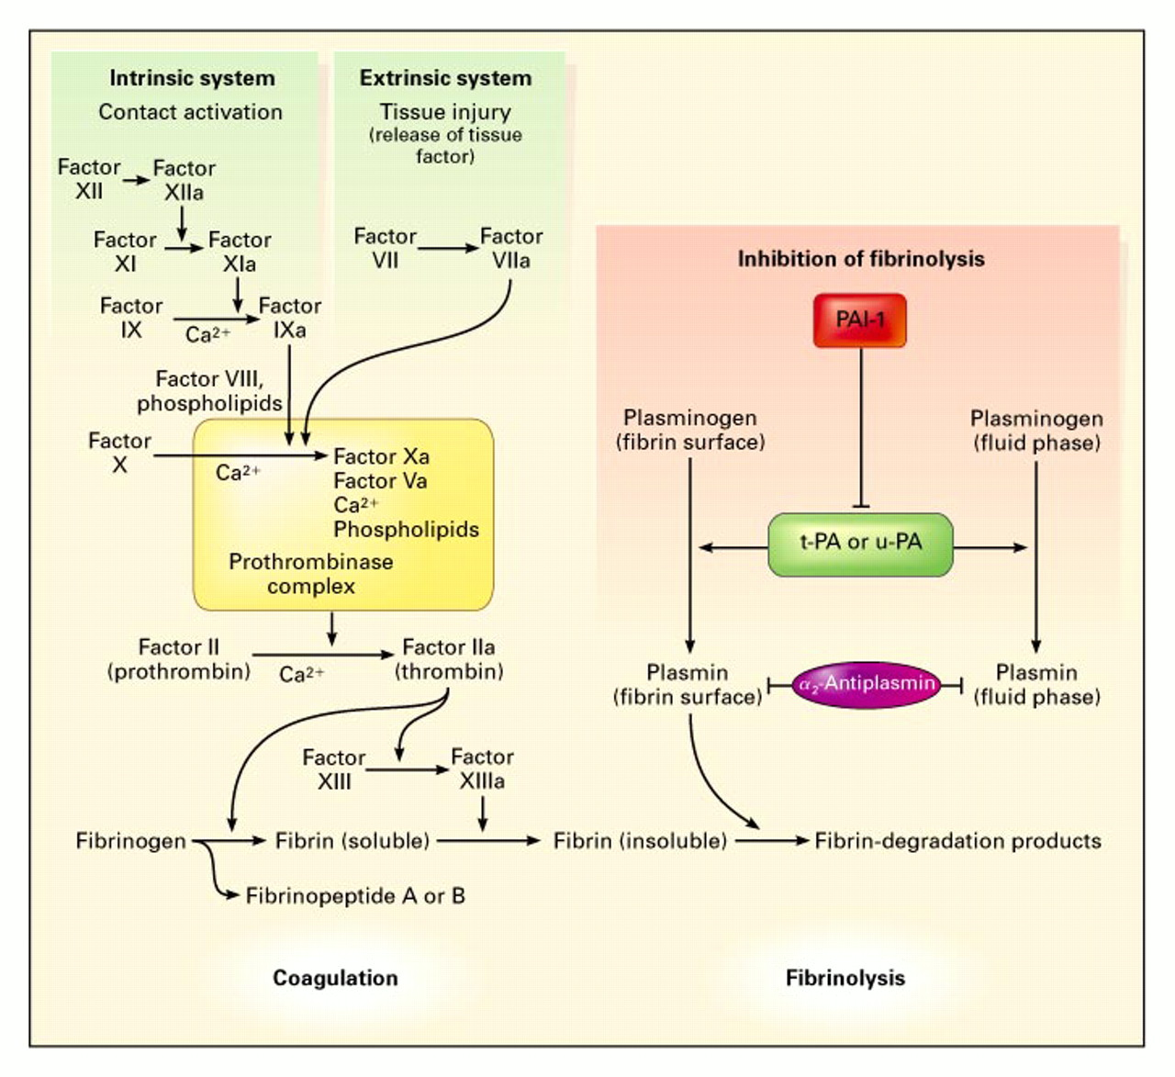

Slide 41
Anticoagulants

Slide 42
Anticoagulants
Anticoagulants : drugs which inhibit fibrin formation.
Classification
Based on mechanism of action
1. Fast and direct acting e.g: Heparin
2. Slow and indirect acting (Oral anticoagulants) e.g Warfarin and Dicumarol

Slide 43
Anticoagulants
Parenteral anticoagulant
Unfractionated heparin
Low molecular weight heparin
Synthetic pentasaccharides :(fondaparinux, idraparinux)
Danaparoid
Antithrombin: Hirudin, Bivalirudin
Synthetic : Argatroban,
Oral anticoagulant
Warfarin, Coumarin,
Acenocoumarol, Phenprocoumon,
Indadione derivative: Anisindione
Rodenticide: pindone
Ximelagatran: Newer Oral Antithrombin

Slide 44
ANTICOAGULANT & ANTITHROMBOTIC DRUGS
Target Drug
Activated clotting factors Heparin
Clotting factors Warfarin
Thrombin Bivalirudin

Slide 45
ANTICOAGULANT & ANTITHROMBOTIC DRUGS
Target Drug
Platelets Aspirin
Clopidogrel
Abciximab
Blood clot r-tissue plasminogen
activator

Slide 46
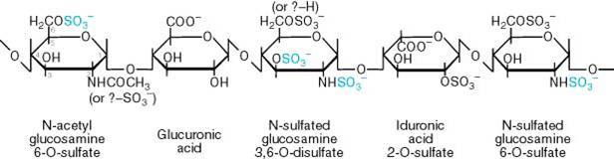
Heparin

Slide 47
Heparin
It is a heterogeneous mixture of sulfated acidic mucopolysaccharides
A glycosaminoglycan found in secretory granules of mast cell.
The unfractionated preparation is extracted from the lung or intestine of ox or pig, and is a mixture of polymers of varying molecular weights.
Low molecular weight heparin : Examples are; Bemiparin, Nadroparin , Reviparin, Enoxaparin, Parnaparin, Certoparin , Dalteparin Tinzaparin

Slide 48
Heparin
Mechanism of action
Heparin activates antithrobimin III (AT III) which inhibits clotting factor proteases (factors IXa, Xa, XIa and XIIa).
inhibits the formation of fibrin clots,
Inhibits the conversion of fibrinogen to fibrin,
Inactivates several of the factors necessary for the clotting of blood.
It is a “suicide substrate’” to serine protease especially activated factor Xa.

Slide 49
Heparin
Clinical Uses
Prevention and treatment of venous thrombosis (DVT),
Atrial fibrillation
Post operative thrombosis and embolism,
Arterial embolus,
Treatment of coronary occlusion,
Acute myocardial infarction
peripheral arterial embolism

Slide 50
Heparin
Administration:
Can be given IV or subcutaneous.
Oral therapy is ineffective because it is inactivated by gastric acids and absorption is minimal because of large molecular size.
Heparin must never be administered intramuscularly because of danger of hematoma formation at injection site.

Slide 51
Heparin
Side effects:
Bleeding is the major side effect,
Allergy,
Alopecia,
Osteoporosis and
Thrombocytopenia

Slide 52
Heparin
Contraindications
Hypersensitive to the drug,
Actively bleeding
Hemophilia,
Thrombocytopenia,
Purpura,
Severe hypertension,
Intracranial hemorrhage,
Infective endocarditis,
Active tuberculosis, etc.

Slide 53
Advantages of LMWH over unfractionated heparin
Effective subcutaneous administration
No need for regular coagulation monitoring due to more predictable dose-response relationship
Improved bioavailability
Longer plasma half life – allows for once-daily dosing
Reduced risk of toxic effects, such as Heparin Induced Thrombocytopenia (HIT) and osteoporosis

Slide 54
Monitoring parameters
Lab: Hb, Plt, Cr, APTT/PT, Anti-Xa level
Bleeding symptoms – hematuria, melena, bruises, bleeding from surgical sites, pain at injection sites
Watch out for sign & symptoms of HIT?
-Platelet<50x10^9, >50% decline from baseline
Perioperative management:
D/C heparin about 6 hours and LMWH about 12-24 hours before operation

Slide 55
Antidote to Heparin Toxicity: Protamine sulphate
Antidote is Protamine sulphate
Heparin/LMWH antagonist (antidote)
Indications:
Hemorrhage due to heparin overdose
Increased risk of hemorrhage is present
Reverse effects of excess heparin following cardiopulmonary bypass procedures

Slide 56
Protamine dosing & administration
1 mg of protamine: 100u of heparin, max of 50 mg of protamine
1mg of protamine: 1mg=100iu of Anti-Xa Enoxaparin
Neutralization of anti-factor Xa activity (max: ~ 60-70%).
Do not exceed 50mg protamine within 10 min
Risk of anaphylactoid-like symptoms if given too rapidly

Slide 57
ORAL ANTICOAGULANT:
WARFARIN

Slide 58
WARFARIN
This compound was originally employed as a rodent poison.
It is the most widely used coumarin anticoagulant and may be considered to be the drug of choice as an oral anticoagulant.
A vitamin K antagonist.

Slide 59
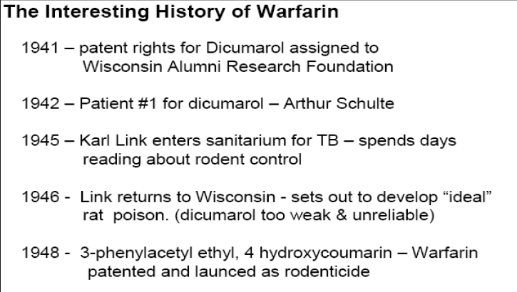
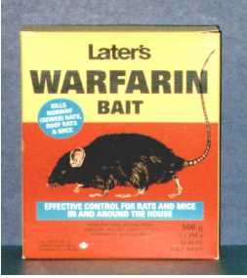

Slide 60
WARFARIN
Mechanism of action
The anticoagulant prevents reductive metabolism of the inactive vitamin K epoxide back to its active form
Warfarin interfere with hepatic synthesis of the vitamin K-dependent coagulation factors II, VII, IX and X.
This is by inhibiting vitamin K1 -2,3 epoxide reductase, preventing vitamin K from being reduced to its active form.

Slide 61
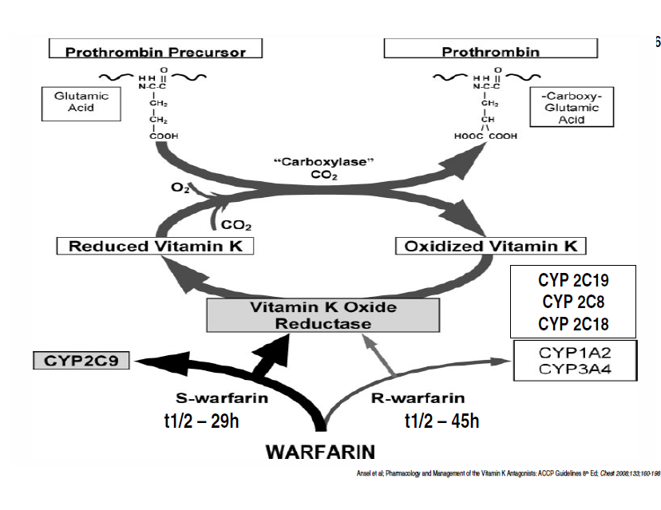
Mechanism of action

Slide 62
WARFARIN
Pharmacokinetics:
It is administered orally as sodium salt and has 100% bioavailability.
The drug has slow onset of action, and long half-life in plasma (36hr) because 99% of the drug is bound to albumin.
Warfarin is metabolized by hepatic cytochrome P-450 (CYP) isoenzymesto inactive metabolites, which are excreted in the bile.
It also is metabolized by reductases to reduced metabolites “warfarin alcohols” , which are excreted in the kidneys.

Slide 63
WARFARIN
Dosing Considerations
Initial dose 2–5mg per day
Maintenance 2–10 mg daily
Dosage adjustments based on PT/INR determinations
INR normal range is 0.9 – 1.2
Therapeutic range is 2 - 3

Slide 64
WARFARIN
Drug Interactions
Divided into:
Pharmacokinetic mechanisms:
(1) enzyme induction (2) enzyme inhibition (3) reduced plasma protein binding.
Pharmacodynamic mechanisms:
(1) synergism (2) competitive antagonism (vitK) (3) an altered physiologic control for vitamin K (hereditary resistance to oral anticoagulants)

Slide 65
WARFARIN
Drug Interactions
The effect of warfarin will be increased when it is used with the following drugs.
Cimitidine, disulfiram, metronidazole, phenylbutazone, ASA and cephalosporin (3rd generations)
The effect of warfarin will be decreased when it is used with the following drugs.
Barbiturates, Cholestyramine, Rifampincin, Diuretics, vit K

Slide 66
WARFARIN
Overdose Management
Without bleeding: cessation of the drug may be enough.
With minor bleeding: by stopping the drug and administering vitamin K1 (Phytonadione) 5-20 mg PO or 10 mg IV.
In emergency situations of severe hemorrhage:
Activated charcoal 1 g/kg PO. vitamin K1 5-20 mg PO or 10 mg IV .
Administering 200-500 mL of fresh whole blood or 15 mL/kg fresh frozen plasma.

Slide 67
WARFARIN
Warfarin—Adverse Effects
Fatal or non-fatal hemorrhage from any tissue or organ
Necrosis of skin and other tissues
Systemic cholesterol microembolization
Alopecia
Purple toes syndrome, urticaria, dermatitis including bullous eruptions.
Teratogenesis

Slide 68
Fibrinolytic drugs

Slide 69
Fibrinolytic drugs
There are three major classes of fibrinolytic drugs:
tissue plasminogen activator (tPA) e.g alteplase, reteplase and tenecteplase.
streptokinase (SK),
and urokinase (UK).

Slide 70
Fibrinolytic drugs
Several fibrinolytic drugs are used in acute myocardial Infarction.
Including
streptokinase,
alteplase,
reteplase
and tenecteplase.

Slide 71
Fibrinolytic drugs
Streptokinase works indirectly, combining with plasminogen to form an activator complex that converts the remaining free plasminogen to plasmin which dissolves fibrin clots.
Alteplase, reteplase and tenecteplase are direct-acting plasminogen activators.
Streptokinase draw back is severe immune reactions and hypotension.

Slide 72
Fibrinolytic drugs
Reteplase and tenecteplase can be given by bolus injection (two injections
intravenously separated by 30 minutes for reteplase, one single
intravenous injection for tenecteplase), whereas alteplase
has to be given by intravenous infusion.

Slide 73
Fibrinolytic drugs
Reteplase and tenecteplase can be given by bolus injection (two injections intravenously separated by 30 minutes for reteplase, one single intravenous injection for tenecteplase)
whereas alteplase has to be given by intravenous infusion.

Slide 74
Fibrinolytic drugs
Urokinase
Urokinase (Abbokinase®; UK) is sometimes referred to as urinary-type plasminogen activator (uPA) because it is formed by kidneys and is found in urine.
It has limited clinical use because, like SK, it produces considerable fibrinogenolysis; however, it is used for pulmonary embolism.
One benefit over SK is that UK is non-antigenic; however, this is offset by a much greater cost.

Slide 75
Thank you for listening!!!!!

